Slide 1
Fall Semester Update
December 16th

Slide 2
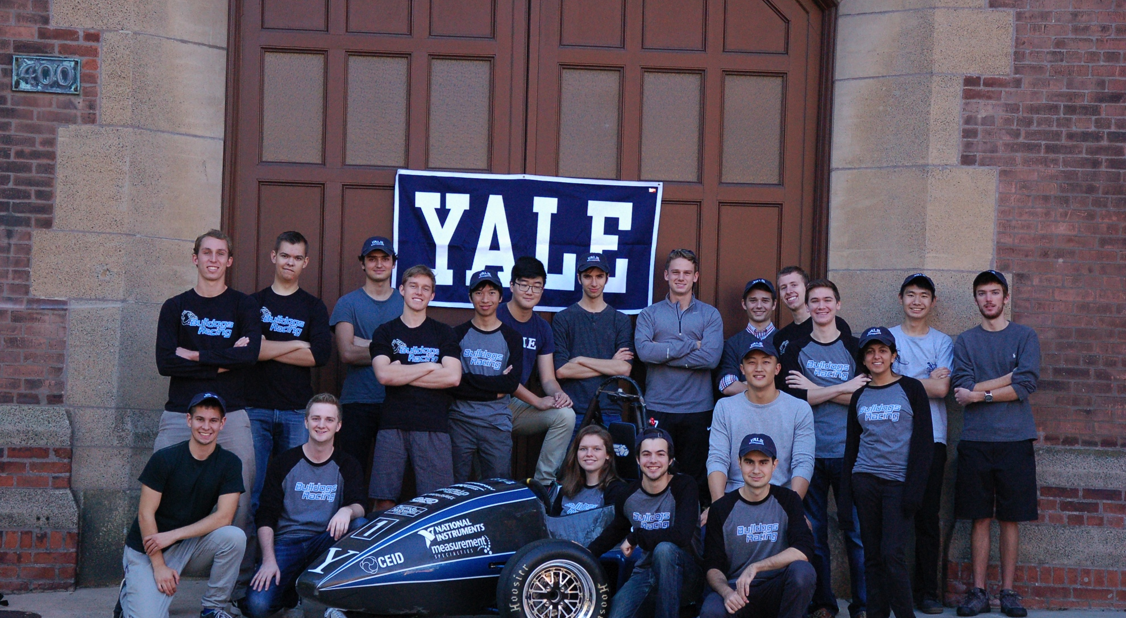
Achievements

Slide 3




Achievements

Slide 4
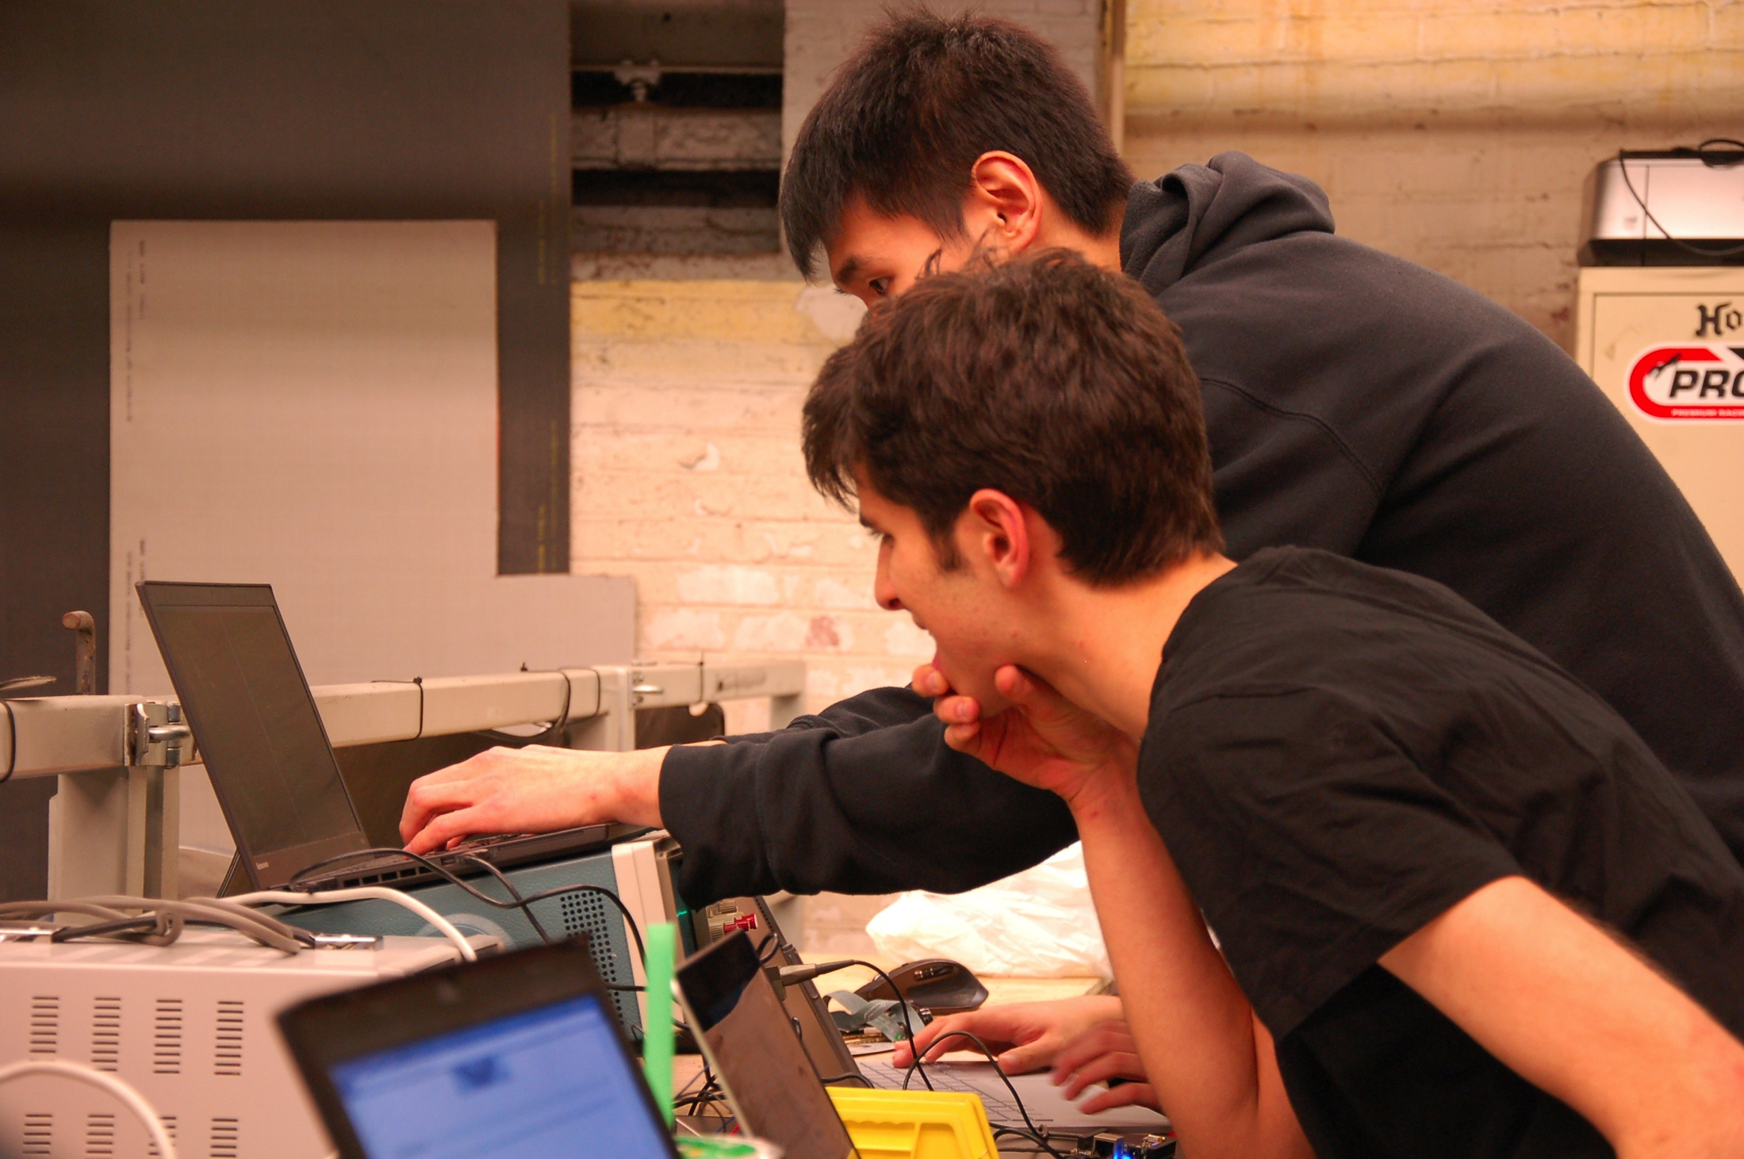
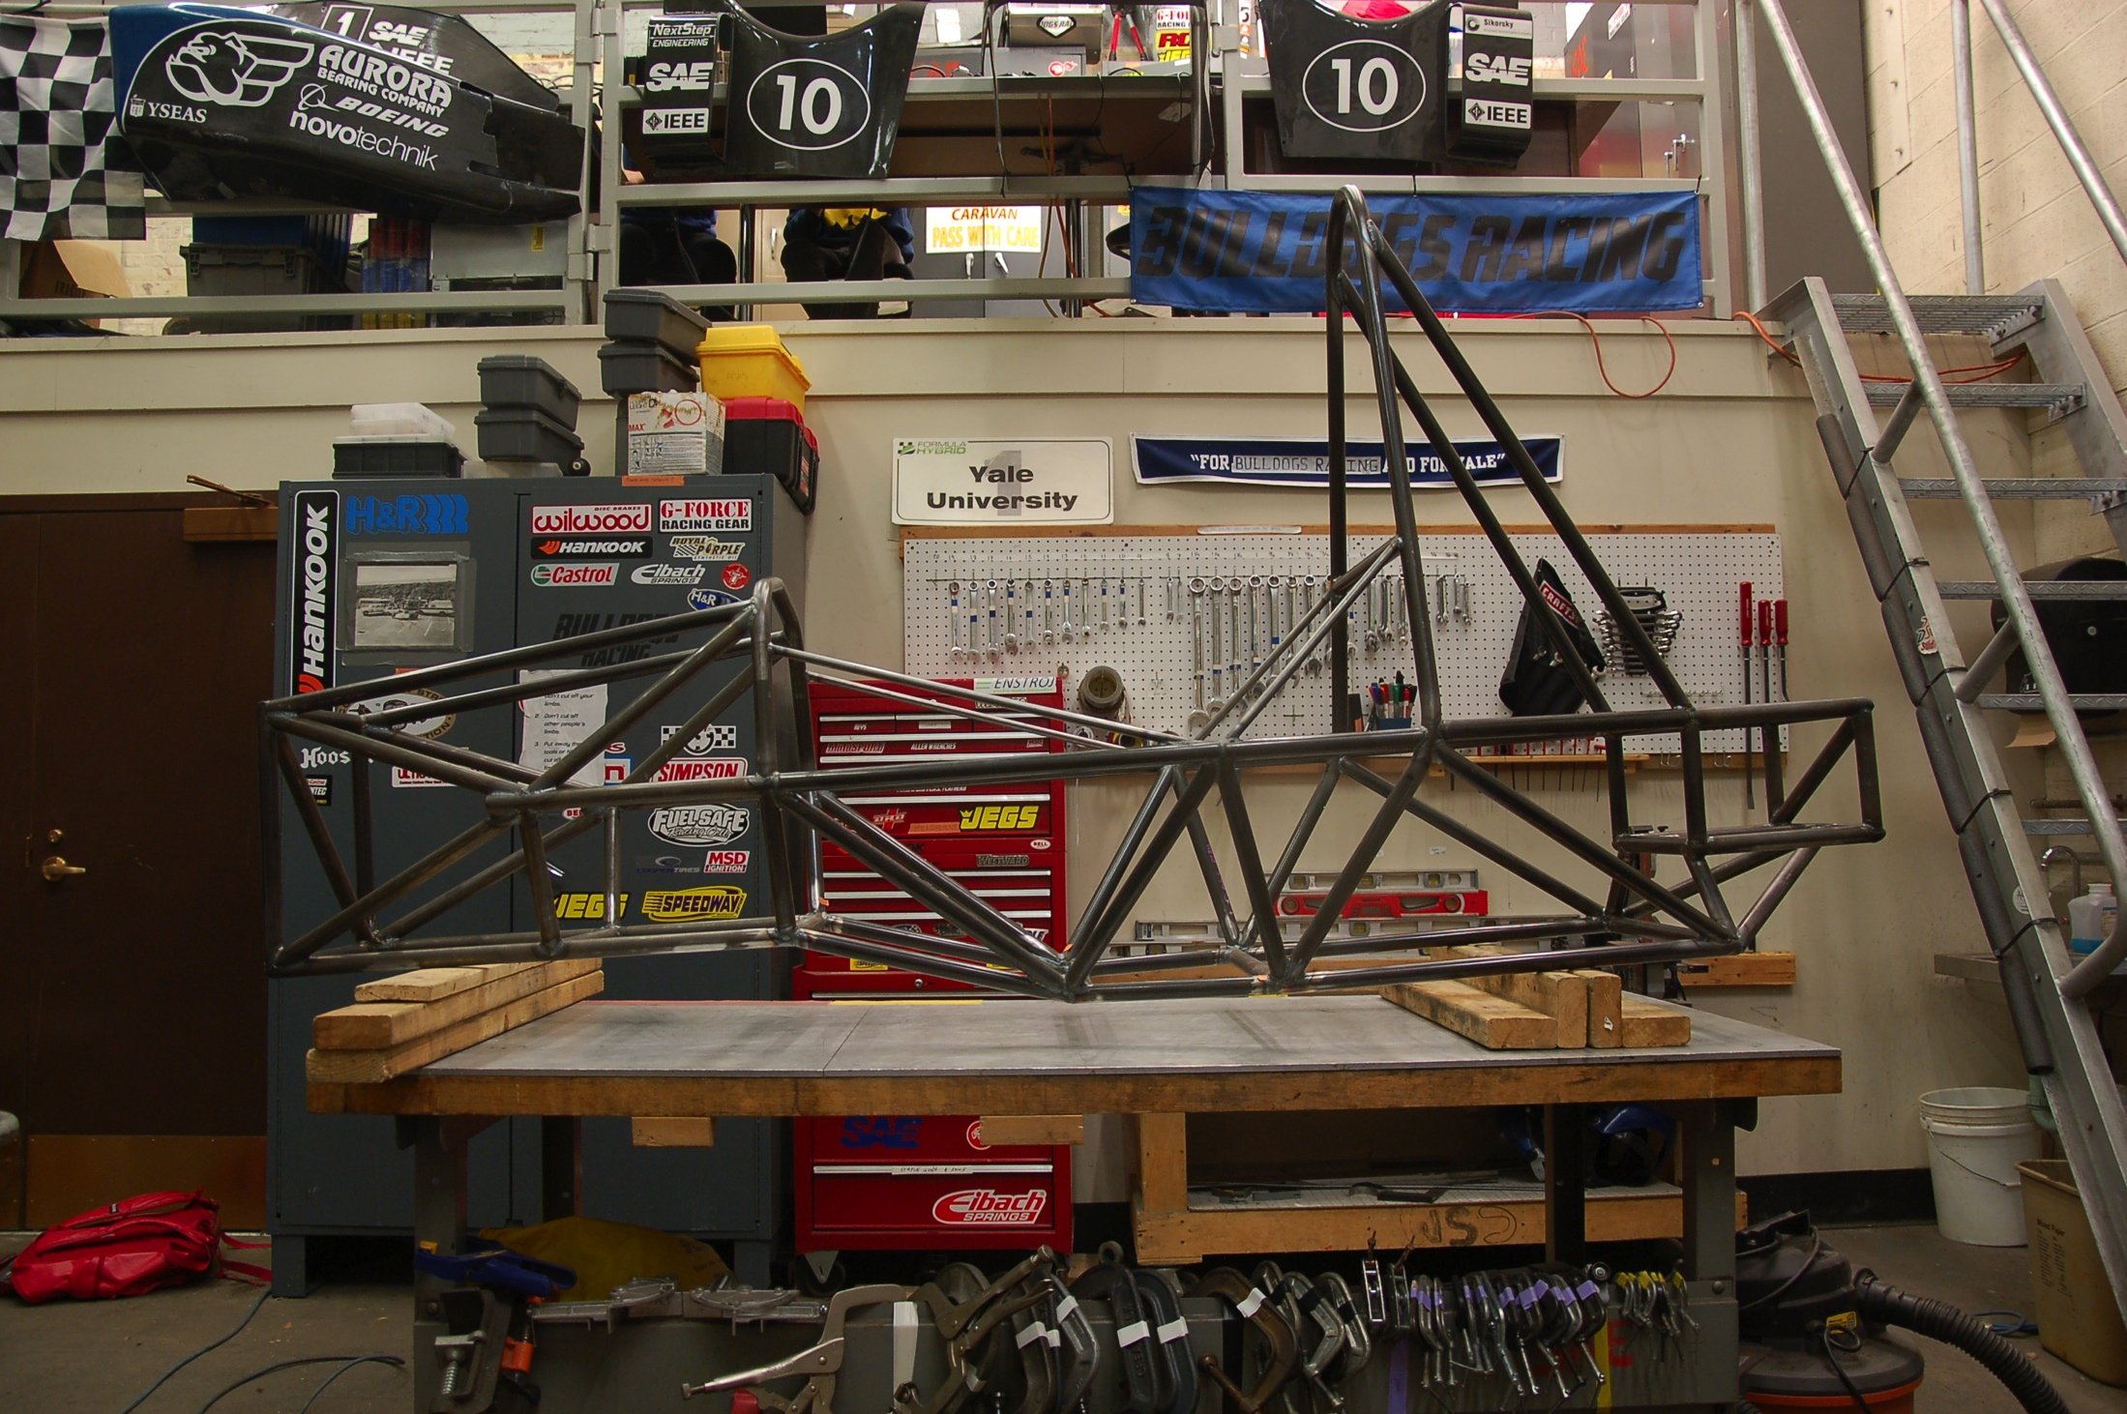
Achievements

Slide 5
Achievements
Notes:
4-5 day seminar focusing on vehicle dynamics from a data standpoint. Started with the tire data and moved towards suspension. It was a lot of work. Got a giant binder and an excel sheet with a lot of the calculation. On the way back, Saw belter’s house.

Slide 6
Goals for the Spring
Communication
Community
Car

